Slide 1

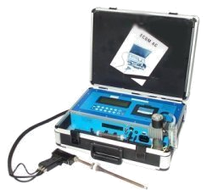
Subpart Z
Toxic and Hazardous
Substances
1910.1000-1450

Slide 2

Introduction
Industrial hygiene is the science of anticipating, recognizing, evaluating, and controlling workplace conditions that may cause workers' injury or illness

Slide 3

Introduction
OSHA relies on, among many others, industrial hygienists to evaluate jobs for potential health hazards
Developing and setting mandatory occupational safety and health standards involves determining:
  The extent of employee exposure to hazards; and,
  Deciding what is needed to control these hazards, in order to protect workers

Slide 4
Introduction
Subpart Z covers the regulations for toxic and hazardous substances in the workplace
Major sections of Subpart Z include:
  1910.1000 Air Contaminants; This section includes OSHA’s Z tables, which set limits on worker exposure to specific listed substances
  1910.1001-1096 Specific regulations for a number of listed potentially hazardous and toxic substances including asbestos (1910.1001); lead (1910.1025) and bloodborne pathogens (1910.1030), among many others (Expanded requirements)
  1910.1200 Hazard Communication

Slide 5
Standard Interpretations
05/23/1985 - Method for exposure compliance determination for substances regulated under Subpart Z.
In response to your letter inquiring how the Occupational Safety and Health Administration (OSHA) makes exposure compliance determinations for substances regulated under Subpart Z of 1910.
Such determinations consider many factors. Workplace conditions (e.g., production levels, control integrity, work practices, etc.) are examined to ensure that representative samples are collected.

Slide 6
Standard Interpretations
05/23/1985 - Method for exposure compliance determination for substances regulated under Subpart Z.
Where feasible, the relative results of direct reading and other analytical results are considered.
Thus, when OSHA determines that employee exposure to a regulated substance exceeds the permissible limits prescribed by our standards, we then also assess employer compliance with all other applicable provisions of the standard that are dependent on employee exposure levels.

Slide 7

1910.1000 - Air Contaminants
An employee's exposure to any substance listed in Tables Z-1, Z-2, or Z-3 cannot exceed the limits given in the tables, according to the requirements set for each table
To achieve compliance with the requirements of this section a hierarchy of controls must first be determined and implemented whenever feasible:
  Engineering controls
  Administrative controls
  Personal protective equipment

Slide 8
Standard Interpretations
06/24/2002 - Hierarchy of controls for exposure to air contaminants
Employers must use engineering or administrative controls to bring employee exposure to airborne contaminants within the levels permitted under 29 CFR 1910.1000.
You may use personal protective equipment (PPE) to supplement engineering and administrative controls only when these controls cannot be feasibly implemented to reduce employee exposure to permissible levels.
Thus, when it is not feasible to achieve compliance through administrative or engineering controls, you must also use PPE or other protective measures to prevent employee exposure to air contaminants from exceeding the prescribed limits.

Slide 9
1910.1000(a) - Table Z-1
Lists common chemicals that may be found in the workplace
Limits are given as either:
  8-hour Time Weighted Average (TWA) or
  Ceiling (C) limits
"Substances with limits preceded by "C" - Ceiling Values." An employee's exposure to any substance in Table Z-1, the exposure limit of which is preceded by a "C", shall at no time exceed the exposure limit given for that substance

Slide 10

1910.1000(a) - Table Z-1
"Other substances" - "8-hour Time Weighted Averages (TWA)”:
  An employee's exposure to any substance in Table Z-1, the exposure limit of which is not preceded by a "C", shall not exceed the 8-hour TWA given for that substance in any 8-hour work shift of a 40-hour work week

Slide 11

Standard Interpretations
11/10/1999 - OSHA policy regarding PEL adjustments for extend work shifts
As stated in a previous memorandum dated November 8, 1996:
Compliance officers can choose one of two approaches for employees who work extended work shifts beyond 8-hours. The choice taken will depend on the nature of the hazardous chemical.

Slide 12
Standard Interpretations
11/10/1999 - OSHA policy regarding PEL adjustments for extend work shifts
The first approach is to sample what the compliance officer believes to be the worst continuous 8-hour work period of the entire extended work shift.
The second approach is to collect multiple samples over the entire work shift. Sampling is done such that multiple personal samples are collected during the first 8-hour work period and additional samples are collected for the extended work shift. Unless a compliance officer is dealing with lead, the PEL in this approach is calculated based upon the worst 8-hours of exposure during the entire work shift.

Slide 13



1910.1000(a) - Table Z-1
The ceiling and 8 hour TWA’s listed in Table Z-1 are expressed in:
  Parts per million (ppm) for gases and vapors from liquids; or,
  milligrams per meter cubed (mg/m³) for dusts, fumes & mists

Slide 14
1910.1000 TABLE Z-1 (Examples)
Substance
8-hr TWA
Ceiling
Acetone
1000 ppm
Carbon monoxide
50 ppm
Chlorine
1 ppm
Particulates not otherwise regulated (PNOR)
15 mg/M³,
Total dust
5 mg/M³,
Respirable fraction
NOTE: The employer must ensure no employee exceeds any PEL

Slide 15

1910.1000(b) - Table Z-2
Table Z-2 was adopted from ANSI* standards
OSHA has developed expanded standards for some of the substances found in Z-2 for example:
  Benzene 1910.1028
  Cadmium 1910.1027
  Formaldehyde 1910.1048
  Methylene chloride 1910.1052
*American National Standards Institute

Slide 16

1910.1000(b) - Table Z-2
The substances listed can have limits expressed as:
  8-hour TWAs
  Ceilings
  Peaks
If a substance has both ceiling and peak limits, the peak now becomes the level never to be exceeded
Any employee’s exposure level exceeding the ceiling but under the peak are required to comply with the margin notes provided in the table
Peak

Slide 17
1910.1000(b) - Table Z-2
Substance
8-hr TWA
Ceiling
Peak
Notes
Carbon Disulfide
20 ppm
30 ppm
100 ppm
30 min
Hydrogen sulfide
20 ppm
50 ppm
10 min
Styrene
100 ppm
200 ppm
600 ppm
5 min in any 3 hrs
Toluene
200 ppm
300 ppm
500 ppm
10 min
* Benzene has an expanded standard 1910.1028. If .1028 does not apply, then the employer will follow limits in Z-2

Slide 18
1910.1000(b) - Table Z-2
"Table Z-2." An employee's exposure to any substance listed in Table Z-2 shall not exceed the exposure limits specified as follows:
  "8-hour time weighted averages." An employee's exposure to any substance listed in Table Z-2, in any 8-hour work shift of a 40-hour work week, shall not exceed the 8-hour time weighted average limit given for that substance in Table Z-2.

Slide 19

1910.1000(b) - Table Z-2
"Acceptable ceiling concentrations." An employee's exposure to a substance listed in Table Z-2 shall not exceed at any time during an 8-hour shift the ceiling concentration limit given for the substance except for:
  A time period, and up to a concentration not exceeding the maximum duration and concentration allowed in the column under "acceptable maximum peak above the acceptable ceiling concentration for an 8-hour shift"

Slide 20

1910.1000(b) - Table Z-2
Example:
  During an 8-hour work shift, an employee may be exposed to a concentration of Substance A (with a 10 ppm TWA, 25 ppm ceiling and 50 ppm peak) above 25 ppm (but never above 50 ppm) only for a maximum period of 10 minutes.
  Such exposure must be compensated by exposures to concentrations less than 10 ppm so that the cumulative exposure for the entire 8-hour work shift does not exceed a weighted average of 10 ppm.

Slide 21

1910.1000(c) - Table Z-3
"Table Z-3." An employee's exposure to any substance listed in Table Z-3, in any 8-hour work shift of a 40-hour work week, shall not exceed the 8-hour time weighted average limit given for that substance in the table

Slide 22



1910.1000(c) - Table Z-3
OSHA adopted this table from the American Conference of Governmental Industrial Hygienist’s (ACGIH) mineral limits

Slide 23
1910.1000(c) - Table Z-3
Substance
PEL
Crystalline Silica
(Respirable fraction)
  10mg/M³
% Sio2 + 2
Coal dust (< 5% SiO2)
2.4 mg/M³
Nuisance dust
  15 mg/M³
Respirable dust
  5 mg/M³

Slide 24
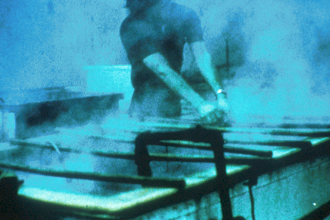
Silica
The Z-3 Table sets the limits for employee exposure to various forms of silica
At least 1.7 million U.S. workers are exposed to respirable crystalline silica in a variety of industries occupations, including construction, sandblasting, and mining

Slide 25

Silica
Silicosis, an irreversible but preventable disease, is the illness most closely associated with occupational exposure to the material, which also is known as silica dust.
Some studies also have linked respirable crystalline silica with risks for lung cancer and some auto-immune diseases.

Slide 26
1910.1000(e) - To achieve compliance
To achieve compliance with the requirements of Tables Z-1, Z-2, and Z-3, a hierarchy of controls must first be determined and implemented whenever feasible:
  Engineering controls
  Administrative controls
  Personal protective equipment

Slide 27
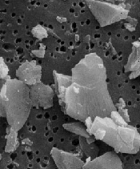
Detailed microscopic view of silica particles on a filter
(Scanning electron micrograph by William Jones, Ph.D.)

Slide 28

1910.1000(e) - To achieve compliance
Any equipment and/or technical measures used for this purpose must be approved for each particular use by a competent industrial hygienist or other technically qualified person
Whenever respirators are used, their use shall comply with 1910.134

Slide 29


Asbestos
CFR 1910.1001

Slide 30
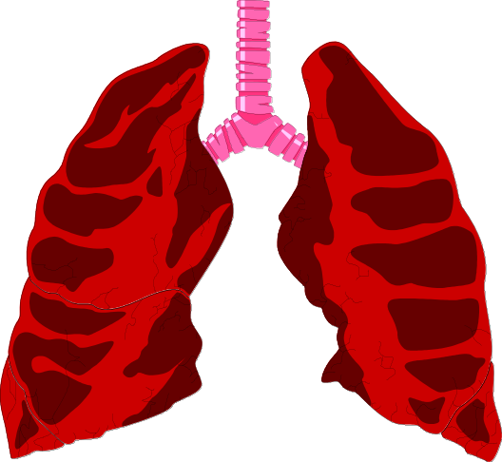

Introduction
The asbestos minerals have a tendency to separate into microscopic-size particles that can remain in the air and are easily inhaled. Persons occupationally exposed to asbestos have developed several types of life-threatening diseases, including lung cancer
A fiber of asbestos or related substance is coated by an iron-protein complex and surrounded by macrophages

Slide 31
Why is asbestos hazardous?
Asbestos is a mineral that is resistant to chemicals, heat and biochemical defenses
Length of fiber is approximately 1/5000 of an inch
Size and shape allows the fiber to reach the alveoli
Fibers remain in the lung tissue or pierce the alveoli and get lodged in the pleura that surrounds the lung
The asbestos kills macrophages which lead to scarring

Slide 32

Permissible exposure limit (PELS)
The employer shall ensure that no employee is exposed to an airborne concentration of asbestos in excess of 0.1 fiber per cubic centimeter of air as an eight (8)-hour time-weighted average (TWA).

Slide 33

Main topics of the Standard
Classification of asbestos work
Regulated areas
Exposure assessment
Engineering and work practice controls
Prohibited activities
PPE
Hygiene facilities
Training requirements
Medical surveillance
Recordkeeping

Slide 34
Standard Interpretations
05/08/1995 - (OSHA) revised asbestos standard
The standard requires the employer to know the presence, location, and quantity of asbestos-containing material (ACM) and presumed asbestos-containing material (PACM) and to communicate this to employees who work in areas where ACM or PACM is present.

Slide 35

Building Owner Requirements
Building and facility owners shall inform employers of employees, and employers shall inform employees who will perform housekeeping activities in areas which contain ACM and/or PACM of the presence and location of ACM and/or PACM in such areas which may be contacted during such activities

Slide 36
Building Owner Requirements
Posting:
  Warning signs shall be provided and displayed at each regulated area.
  In addition, warning signs shall be posted at all approaches to regulated areas so that an employee may read the signs and take necessary protective steps before entering the area.
DANGER
ASBESTOS
CANCER AND LUNG DISEASE
HAZARD
AUTHORIZED PERSONNEL ONLY

Slide 37
Standard Interpretations
02/21/1996 - Building and/or facility owner notification requirements
Rule 29 CFR 1926.1101(k)(2)(ii)(B) pertains to employees of the building and/or facility owner.
The rule requires the owner to notify his/her maintenance and custodial employees of the presence, location, and quantity of ACM or PACM in the areas of the building or facility where they perform work.
In addition, the rule requires the owner to notify his/her other employees who work in or adjacent to areas where work about to take place of the presence, location, and quantity of ACM or PACM in the areas.

Slide 38

Lead
1910.1025

Slide 39
Introduction
Overexposure to lead is one of the most common overexposures found in industry.
A leading cause of workplace illness.
OSHA has established the reduction of lead exposure to be a high strategic priority.
OSHA's five year strategic plan sets a performance goal of a 15% reduction in the average severity of lead exposure or employee blood lead levels in selected industries and workplaces.

Slide 40

Introduction
Lead is commonly added to industrial paints because of its characteristic to resist corrosion.
Industries with particularly high potential exposures include: construction work involving welding, cutting, brazing, blasting, etc., on lead paint surfaces;
Oral ingestion may represent a major route of exposure in contaminated workplaces.

Slide 41
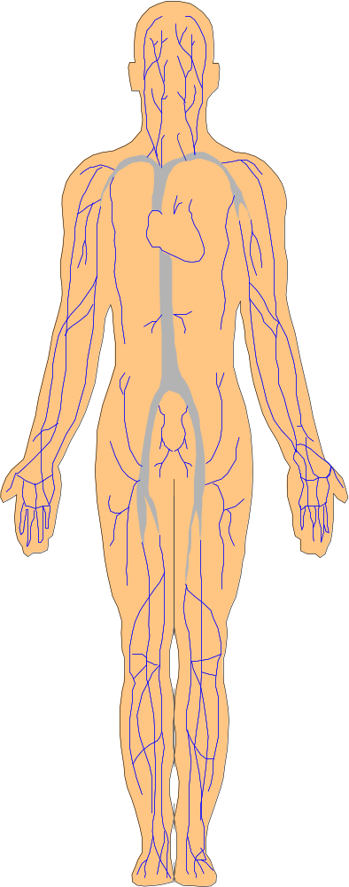
Introduction
You may not be aware of any immediate symptoms of disease
Lead stored in your tissues can slowly cause irreversible damage, first to individual cells, then to your organs and whole body systems

Slide 42

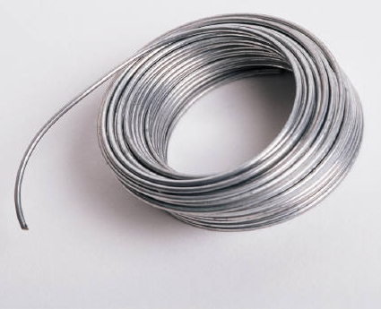
Introduction
You can absorb lead through your digestive system if lead gets into your mouth and is swallowed
If you handle food, cigarettes, chewing tobacco, or make-up which have lead on them or handle them with hands contaminated with lead, this will contribute to ingestion

Slide 43

Introduction
Taken in large enough doses, lead can kill you in a matter of days
A condition affecting the brain called acute encephalopathy may arise which develops quickly to seizures, coma, and death from cardiorespiratory arrest.
A short term dose of lead can lead to acute encephalopathy

Slide 44

Introduction
Overexposure to lead may result in severe damage to your blood-forming, nervous, urinary and reproductive systems
Common symptoms of chronic overexposure include loss of appetite, metallic taste, anxiety, constipation, nausea, weakness, insomnia, headache, nervous irritability, muscle and joint pain or soreness, tremors, numbness, dizziness

Slide 45

Scope
Applies to all occupational exposure to lead
This section does not apply to the construction industry or to agricultural operations covered by 29 CFR Part 1928

Slide 46
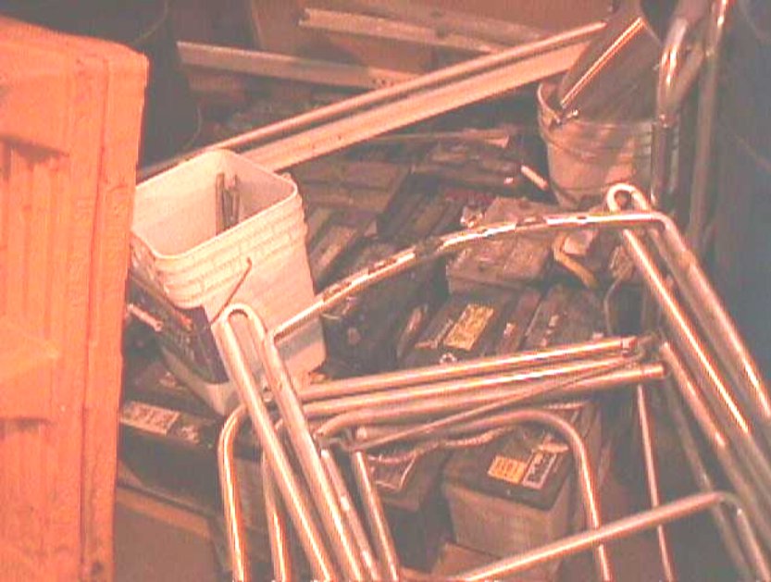
Permissible exposure limit (PEL)
The employer shall assure that no employee is exposed to lead at concentrations greater than fifty micrograms per cubic meter of air (50 ug/m(3)) averaged over an 8-hour period

Slide 47
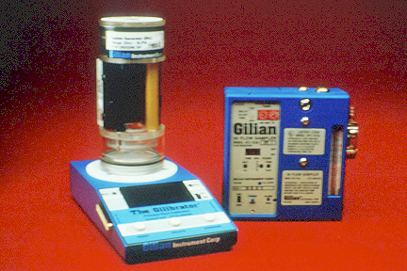
Initial determination
Each employer who has a workplace or work operation covered by this standard shall determine if any employee may be exposed to lead at or above the action level

Slide 48
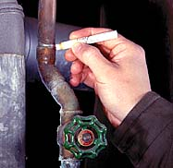
Basis of initial determination
Any information, observations, or calculations which would indicate employee exposure to lead;
Any previous measurements of airborne lead; and
Any employee complaints of symptoms which may be attributable to exposure to lead

Slide 49

Negative Determination
Written Record
Date
Location
Name
SSN
Pb Negative

Slide 50

Written Compliance Program
A written program is required if exposures are above PEL:
  Each employer shall establish and implement a written compliance program to reduce exposures to or below the permissible exposure limit
Pb Control

Slide 51
Written Compliance Program
A description of each operation in which lead is emitted;
  e.g. machinery used, material processed, controls in place, crew size, employee job responsibilities, operating procedures and maintenance practices;
A description of the specific means that will be employed to achieve compliance, including:
  methods selected for controlling exposure to lead;
Air monitoring data which documents the source of lead emissions;
A schedule for implementation of the program

Slide 52
Additional Requirements
Mechanical Ventilation
Respirator Selection & Use and PPE clothing
Housekeeping
Hygiene and Facility Practices
Medical Requirements
Training

Slide 53
Standard Interpretations
04/25/1979 - Training program requirements in the lead standard
The employer is required by provision (1)(l)(v)(A) of the lead standard to summarize the standard and its appendices for each employee covered by provision (1)(l)(ii).

